Slide 1

KEVA Ancient mineral DROPS
KEVA
INDUSTRIES
Brings First Time In India
Formulated In Europe

Slide 2

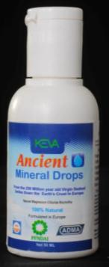
About Keva Ancient Mineral Drops
(KAMD)
A 100% Natural Magnesium Chloride
Is a Quality Controlled product produced under GMP regulations and certification.

Slide 3
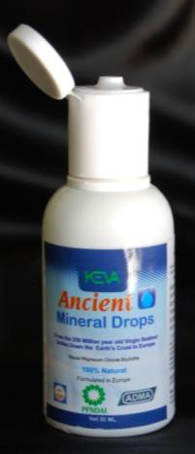
About Keva Ancient Mineral Drops
(KAMD)
Is obtained from the 250 million year old virgin seabed 2 miles down the earth’s crust in Europe.

Slide 4

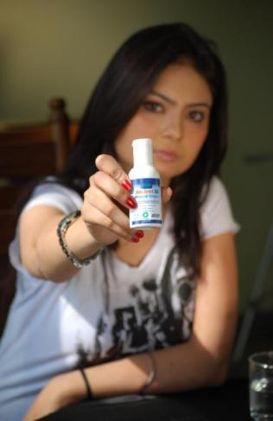
About KAMD
You can find up to 84 ionic trace minerals in KAMD
It is the purest magnesium in the world

Slide 5
About KAMD
Its’ quality is highest available and is constantly controlled through International quality standards
It is formulated by nature for enhanced energy, vitality & healthy living.

Slide 6
Need of KAMD
KAMD saves people from a considerable amount of pain and suffering as magnesium is essential for life and is a true cellular tonic that helps us heal from varied sufferings

Slide 7
Need of KAMD
Contains only raw, highly concentrated, ultra pure magnesium chloride and other trace minerals drawn from the ancient virgin seabed in Europe

Slide 8

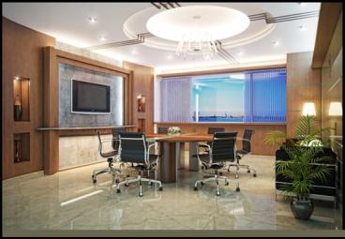

ABOUT KEVA INDUSTRIES
Keva Industries is an ISO 9001:2008 certified company which is a leading developer and supplier of wellness and healthcare products in India.

Slide 9

Keva Ancient Mineral Drops (KAMD) is an excellent product introduced first time in India under license from
NAYO PHARMA based in
LONDON, UNITED KINGDOM

Slide 10

Benefits of KAMD
Facilitates safe and effective detoxification
Relief of aches, pains, spasms
Elevates mood and relieves stress
Encourages healthy skin tissue & protects against skin disorders
Fights depression
Helps maintain proper muscle function
Supports a healthy immune system
Balances the hormonal system

Slide 11
Calms overactive nerves
Improves quality of sleep
Managing disorders like hypertension, migraines, arthritis etc.
Maintains healthy blood sugar levels
Improves & strengthens bones, joints & teeth
Helpful for neuro disorders
Promotes a healthier cardiovascular system
Increases energy, vitality & improves health

Slide 12







How does KAMD work in human body?
KAMD activates the body’s system which includes:
Urinary system
Intestines
Skin
Lungs
Lymphatic System
Liver

Slide 13
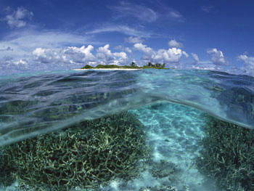
Need & importance of Magnesium
Magnesium is needed for more than 300 biochemical reactions in the body.
It helps maintain normal muscle and nerve function, keeps heart rhythm steady, supports a healthy immune system and keeps bones strong.
Magnesium regulates blood sugar levels, promotes normal blood pressure and is known to be involved in energy metabolism and protein synthesis.

Slide 14

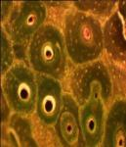
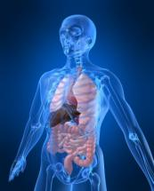
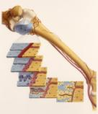
Magnesium Deficiency: A serious problem
Even if a person is very deficient in magnesium, the body keeps the blood level normal by pulling magnesium from bone and tissue cells.

Slide 15

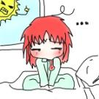
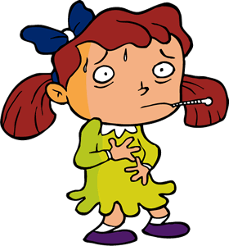
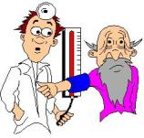

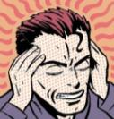
Magnesium Deficiency: A serious problem
A person can have a major magnesium deficiency and still have normal magnesium blood levels.
But magnesium deficiency can lead to serious problems, if ignored !!

Slide 16

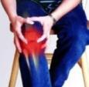


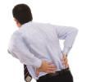

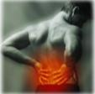

As per Dr Carolyn Dean, M.D., N.D. ,
magnesium deficiency causes the following conditions:
Anxiety
Panic attacks
Asthma
Blood clots
Bowel disease
Depression
Detoxification
Diabetes
Fatigue
Heart disease
Hypertension
Insomnia
Kidney Disease
Liver Disease
Migraine
Musculoskeletal conditions
Nerve problems
Gynaecological problems
Osteoporosis
Raynaud's Syndrome
Tooth decay
Hypoglycemia

Slide 17
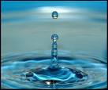

What Doctors Say About Magnesium Around The World:
Dr. Lawrence Resnick, Cornell University- "Without enough magnesium, cells simply don’t work."
Dr. Mildred S. Seelig, author of "The Magnesium Factor"- “Most modern heart disease is caused by magnesium deficiency.”

Slide 18

What Doctors Say About Magnesium Around The World:
Bones researcher Katherine Tucker, Tufts University- "If magnesium is deficient, bones are more fragile."
Dr. Zachary T. Bloomgarden- "Studies have shown that 90 percent of individuals with type II diabetes have low levels of free intracellular red blood cell magnesium.”

Slide 19
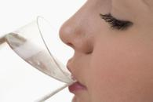
HOW TO USE KEVA ANCIENT MINERAL DROPS ?
Recommended dosage for internal use
Weekly dosage for individuals aged 21 years or above
1st Week | 2nd Week | 3rd Week | 4th Week
4 drops morning 4 drops evening | 6 drops morning 6 drops evening | 8 drops morning 8 drops evening | 10 drops morning 10 drops evening
(Dilute these drops in your drinking water)

Slide 20
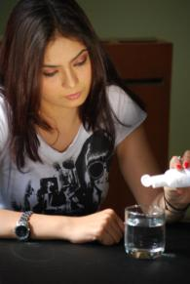
Dos’ & Don’ts for KAMD
For best results, KAMD should be taken twice daily, i.e. morning & evening, on an empty stomach.
Drink KAMD only in a glass tumbler and consume food after half an hour.

Slide 21
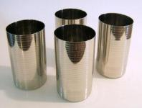
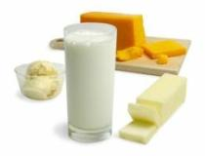
Dos’ & Don’ts for KAMD
Do not drink KAMD in steel or any other metal glass nor use any metal spoon to mix it.
Do not mix KAMD in milk or any other dairy product.

Slide 22
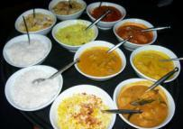
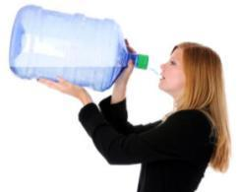
Dos’ & Don’ts for KAMD
Do not put KAMD on hot food, tea etc.
It is extremely essential to drink a lot of water, while taking KAMD, to remove the toxins that are released from the body.

Slide 23


Dos’ & Don’ts for KAMD
It is recommended to drink plenty of water with KAMD. Drink minimum 3 liters of water daily.
Healthy adults may take KAMD as per above dosage table for first month and then gradually decrease the dose & maintain at 10 drops/day.

Slide 24
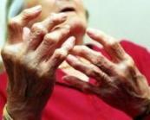
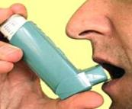
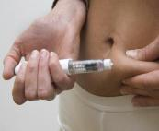
Dos’ & Don’ts for KAMD
Any patient suffering from diseases like arthritis, diabetes, cancer, asthma etc must increase the dosage to 25-30 drops a day after the 4th week.
However if any irritation persists during the course then gradually decrease the dose to the minimum.

Slide 25
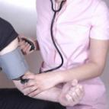
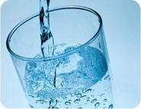
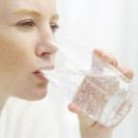
Dos’ & Don’ts for KAMD
In patients with Hypertension, BP might shoot up initially hence it is advisable to start with 5 drops of KAMD a day and then gradually increase the dose.
If BP increases, reduce the dose and drink excessive water.

Slide 26
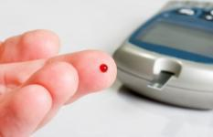
Dos’ & Don’ts for KAMD
In Diabetic patients, blood sugar may rise initially so it is advisable to start with 5 drops of KAMD a day and then gradually increase the dose. If blood sugar increases, reduce the dose and drink excessive water.

Slide 27
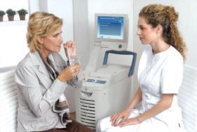
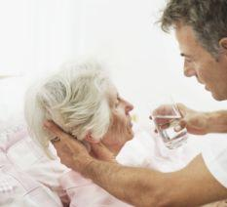
Dos’ & Don’ts for KAMD
In patients undergoing dialysis, patient should be given 1-2 drops daily until they are allowed to increase the water intake.

Slide 28
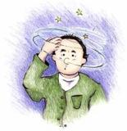

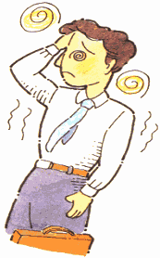
Dos’ & Don’ts for KAMD
Moderately increased dosages are safe if needed or desired, but larger amounts may cause a laxative effect.

Slide 29
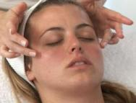
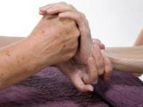
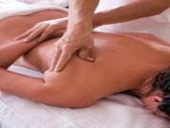
Recommended Dosage for External Use
For Skin diseases:
There is no maximum recommended use for the skin. The skin cannot absorb more than it can have, so use just a few drops & massage well on the skin.

Slide 30
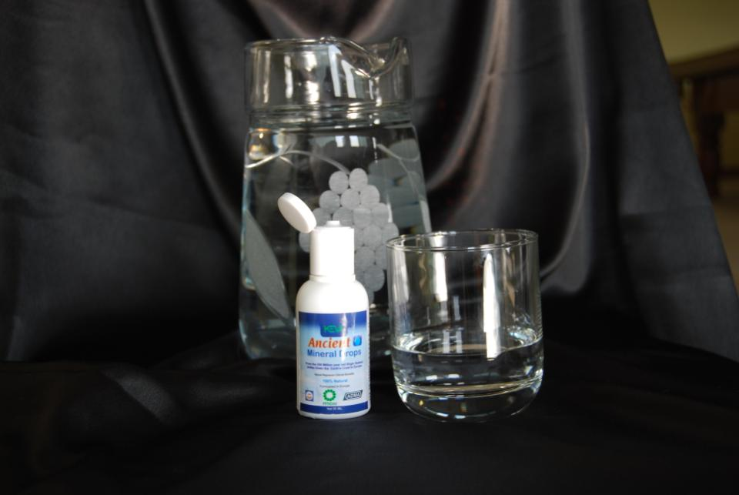
For Skin diseases:
It is suggested to start with 20 drops initially. The dosage can be increased as per requirement.

Slide 31
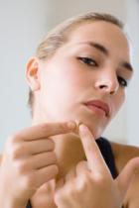
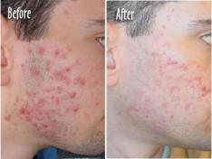
For Skin diseases:
Massage well & let the skin absorb all the liquid. This will help in relieving from problems of acne, pimples, blemishes etc. or any other skin problem like dermatitis, psoriasis etc.

Slide 32
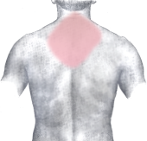
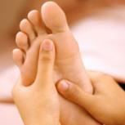
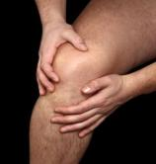
For Skin diseases:
Suggested 20 drops initially are to be applied on one certain area of body only wherever problem is seen.
Damaged skin or skin that is in bad health can have a stinging sensation when you use KAMD.

Slide 33

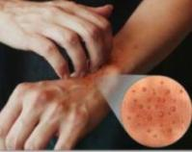
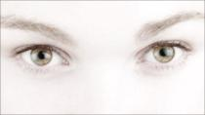
For Skin diseases:
If any irritation persists then decrease the dosage. After using a few times the skin will handle the magnesium better.
Be careful with the eyes & with other sensitive parts of the body.

Slide 34
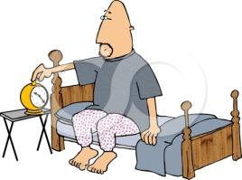
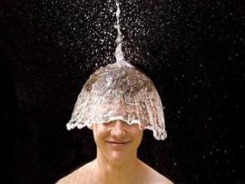
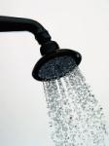
For Skin diseases:
Moderately increased dosages are safe if needed or desired.
For better results apply KAMD daily after shower & before going to bed.

Slide 35
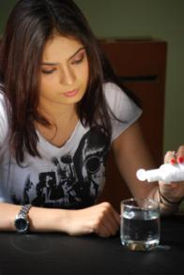
For pain in joints, ankles, shoulders, back, neck, cervical etc.
It is suggested to start with 20 drops initially. The dosage can be increased to 30 drops after a week which can be increased upto 40 drops as per requirement.

Slide 36
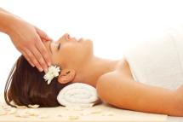
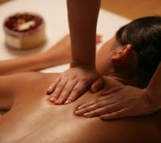
For pain in joints, ankles, shoulders, back, neck, cervical etc.
Massage well & let the skin absorb all the liquid.
Suggested 20 drops initially are to be applied on one certain area of body only wherever pain is felt.

Slide 37


For pain in joints, ankles, shoulders, back, neck, cervical etc.
If any irritation persists then decrease the dosage. After using a few times the skin will handle the magnesium better.
Moderately increased dosages are safe if needed or desired.

Slide 38


For pain in joints, ankles, shoulders, back, neck, cervical etc.
For better results apply KAMD daily after shower & before going to bed.
Use KAMD regularly for few months as a daily habit.

Slide 39



For Internal Disorders
Daily massage your feet before going to bed.
This will help in managing internal disorders like hypertension, arthritis, diabetes, neuro disorders etc. and also strengthen bones & joints.

Slide 40

For Internal Disorders
It is suggested to start with 20 drops initially. The dosage can be increased to 30 drops after a week which can be increased upto 40 drops as per requirement.
If any irritation persists then decrease the dosage. After using a few times the skin will handle the magnesium better.

Slide 41


For Internal Disorders
If no difference is seen in health even after 2-3 weeks of foot massage then it denotes that there is severe magnesium deficiency in the body.
For such it is suggested to go for full body massage twice a week.

Slide 42






For Internal Disorders
Full body massage includes full massage on hands, legs, back, neck etc.

Slide 43



For Internal Disorders
Suggested 20 drops initially are to be applied on one part of body that is 20-20 drops on hands, 20-20 drops on legs & so on.
Be careful with the eyes & with other sensitive parts of the body.

Slide 44



For Internal Disorders
Moderately increased dosages are safe if needed or desired.
For better results apply KAMD before going to bed.

Slide 45



For healthy life
Daily massaging of feet will be beneficial for a healthy life. It will give a refreshing feeling.
Full body massage done twice a week will help in relieving from stress, enhance energy & vitality in the body & stay healthy.

Slide 46


For healthy life
It is suggested to start with 20 drops initially. The dosage can be increased to 30 drops after a week which can be increased upto 40 drops as per requirement.
If any irritation persists then decrease the dosage. After using a few times the skin will handle the magnesium better.

Slide 47



For healthy life
Suggested 20 drops initially are to be applied on one part of body that is 20-20 drops on hands, 20-20 drops on legs & so on.
Be careful with the eyes & with other sensitive parts of the body.

Slide 48


For healthy life
Moderately increased dosages are safe if needed or desired.
For better results apply KAMD daily before going to bed.

Slide 49



Testimonials
I was feeling weak, stressed out with sleeplessness & completely unable to manage with my family life & professional life. Life was very hectic. But after using Keva Ancient Mineral Drops I feel every day very much refreshing with no stress at all.
Emily Fisher
Female
36Yrs
U.K

Slide 50

Testimonials
I had damaged the skin of my feet after prolonged wearing of shoes due to excessive office hours without any break but Keva Ancient Mineral Drops has done wonders & my feet are back to normal.
Louis Walter
Male
54 yrs
Germany

Slide 51

Testimonials
I was in depression some time back due to unemployment with excessive headache but after using Keva Ancient Mineral Drops, I felt the difference within 3-4 weeks.
Michael Peck
Male
25 yrs
Spain

Slide 52

Testimonials
I was fed up of diabetes, pain in joints, backache. Then I came to know about Keva Ancient Mineral Drops & used well as per directions & saw great results. I am using it for last 2 months now.
Kia Johansson
Female
38 yrs
Sweden

Slide 53

Testimonials
I had become a patient of high blood pressure due to wrong eating habits & busy professional life. Then I came to know about Keva Ancient Mineral Drops from my friend. I started applying & consuming it & started feeling better in a month. Now I am absolutely normal.
Luciano Romano
Male
43 yrs
Italy

Slide 54


Slide 55
Contact:
Keva Industries
An ISO 9001:2008 Certified Company
Level 2, Prestige Omega,
No. 104, EPIP Zone,
Whitefield, Bangalore-560066 (India)
Web: www.kevaind.org

Slide 56

Note: This product is not intended to treat, cure or prevent any disease. Please consult your health care professional.

