Slide 1
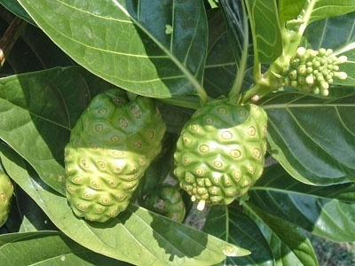
KEVA NONI
KEVA
INDUSTRIES
Brings First Time In India
In Technical Collaboration with
DROI PHARMA
CALIFORNIA, USA

Slide 2


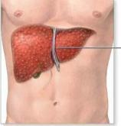
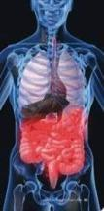

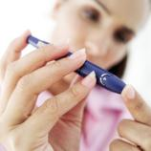

Are you suffering from any of these problems?
LIVER PROBLEM
DIGESTION PROBLEM
HEART PROBLEM
DIABETES
GENERAL HEALTH PROBLEMS IN WOMEN

Slide 3

Then We Have A Good News For You!
AS KEVA INDUSTRIES HAS BROUGHT A HEALING SOLUTION FOR ALL THESE PROBLEMS FIRST TIME IN COLLABORATION WITH DROI PHARMA BASED IN USA

Slide 4

THE BEST PART ABOUT THIS SOLUTION IS THAT IT IS NOT A CURING SOLUTION BUT ALSO A PREVENTIVE MEASURE TOWARDS A BETTER HEALTH & WELL BEING
YES, YOU CAN SWITCH OVER TO THIS SOLUTION IN ADVANCE & IN TIME AS A PERMANENT RELIEF & LIVE A HEALTHY LIFE!

Slide 5



ABOUT KEVA INDUSTRIES
Keva Industries is an ISO 9001:2008 certified company which is a leading developer and supplier of wellness and healthcare products in India.

Slide 6
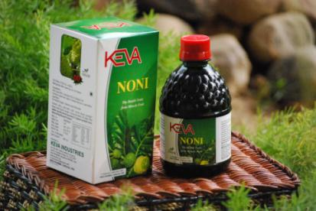
SOLUTION BY KEVA INDUSTRIES
KEVA NONI
Most exciting and promising Natural Health Enhancer
Helps "sick" cells return to normal

Slide 7
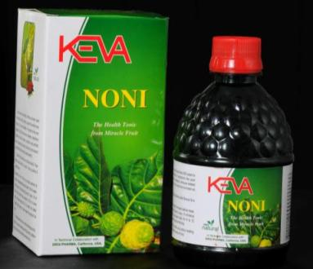
WHAT IS KEVA NONI?
Keva Noni is a concentrated juice extracted from Noni.
It is based on the latest grape juice extraction technology being used in California, USA for making natural health products.

Slide 8
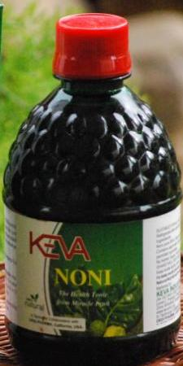
Keva Noni enriches our body with vitamins A, C, E, B, B2, B6, B12, Calcium, Iron, Niacin, Folic Acid, Pantothenic Acid, Phosphorus, Magnesium, Zinc, Copper and other minerals like Chromium, Manganese, Molybdenum, Sodium, Potassium, Carbohydrates and 160+ isolated nutrients

Slide 9

Keva Noni is considered as a balancing agent and stabilizes the body in maintaining perfect health.
It has the world's richest source of cellular rejuvenating enzymes.
It is a nutritional food that supports body cells and leads to healthy body.

Slide 10
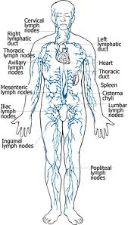
Keva Noni detoxifies and cleanses the user’s body and on the other side, it builds and strengthens the cells of our body.
It has health-enhancing attributes that are Anti-bacterial, Anti-inflammatory, Adaptogen, Analgesic, and Anti-congestive.

Slide 11

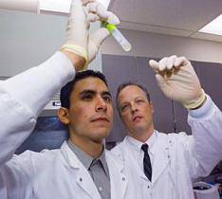
A RENOWNED SOLUTION
At this time Noni is being studied in over 45 universities worldwide.
Scientists have found more than 160 nutrients in it.
It has been used by millions of people worldwide for more than 2000 years with life changing results.

Slide 12
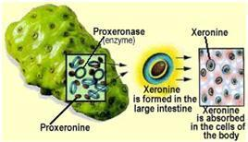
HOW KEVA NONI WORKS?
Keva Noni is a cellular food which has a rich source of Proxeronine being a precursor for Xeronine a molecule required by many proteins of our body.

Slide 13
HOW KEVA NONI WORKS?
Xeronine assists in enlarging the pores of the cell membrane allowing better absorption of micro nutrients and medicines and supports protein metabolism.

Slide 14
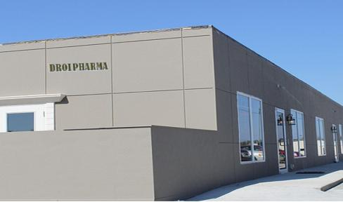
Keva Noni is a quality product introduced first time in India in technical collaboration with
DROI PHARMA based in
California, USA

Slide 15
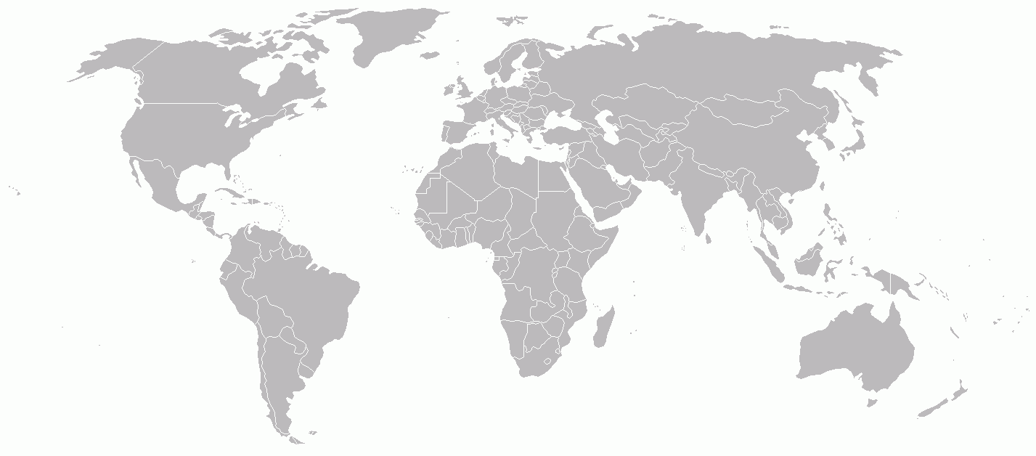
WHERE DOES IT COME FROM?
Noni is a natural fruit, scientifically known as Morinda Citrifolia ,which comes from a small evergreen tree , indigenous to South-East Asia, South Pacific , West Indies, Fiji, Vietnam and Tropical areas of Queensland.

Slide 16

WHERE DOES IT COME FROM?
Pure water and clear air of these areas create perfect environment to grow nutrient rich Noni.
And ripe Noni fruits result in the highest level of compounds possibly responsible for the therapeutic and biological activity of the fruits.
Noni is also known as “Beach Mulberry”

Slide 17
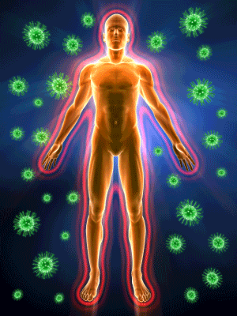
BENEFITS OF KEVA NONI
Detoxifies our body
Boosts Immune system
Regulates Protein in the body
Regulates proper cell functioning
Improves metabolic system
Rejuvenates the cells of the body

Slide 18
BENEFITS OF KEVA NONI
Reduces the risk of cancer
Relieves pain as an analgesic
Purifies blood
Manages body weight
Helpful in Diabetes
Relieves stress and helps to stay calm and relaxed

Slide 19
BENEFITS OF KEVA NONI
Stabilizes Blood Pressure
Maintains healthy skin, hair and scalp
Manages disorders like heart ailments and strokes
Improves digestion
Helps body system to function properly
(as an adaptogen)

Slide 20
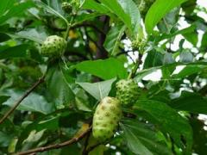
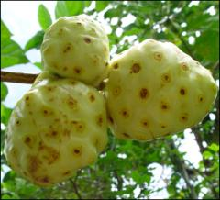
The History of Noni –
Traditional and Medicinal Uses
Noni is a fruit that has been around for nearly 2000-3000 years.
Over 40 different medicinal remedies can be identified by researchers that were used traditionally by different cultures.

Slide 21
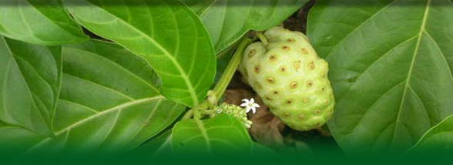
The History of Noni –
Traditional and Medicinal Uses
The history of Noni tells us about the more widely known traditional uses and medicinal uses of the different parts of Noni that have been used to help heal wounds, to treat infections and also to treat diabetes, fevers and skin problems.

Slide 22
Below is a table that shows some of the other traditional and medicinal uses of Noni separated by the different parts of the tree used:
Plant Part Used | Traditional Medicinal Uses
Leaves | Relieves tuberculosis, sprains, deep bruising, bone fractures, hypertension, stomach ache, diabetes, loss of appetite, urinary tract ailments, hernias etc.

Slide 23
Plant Part Used | Traditional Medicinal Uses
Fruit | Asthma, broken bones, sores or scabs, sore throat, cracking of toes and feet, cuts, wounds, mouth and gum infections, toothaches etc.
Fruit juice | Regulate menstrual flow, urinary tract problems, arthritis
Stem | Jaundice, hypertension
Seed | Scalp insecticide, insect repellant
Leaves, flowers, fruit, bark | Eye conditions, skin wounds, abscesses, gum and throat disease, respiratory ailments, constipation, fever, laxative

Slide 24

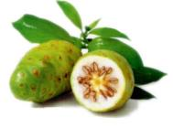
Modern Uses of Noni Complementing the Traditional and Medicinal Uses
Addictions, allergies, arthritis, asthma, brain problems, burns, cancer, cardiovascular disease, chemical sensitivity, chronic fatigue, diabetes, digestive problems, endometriosis, fibromyalgia, gout, hypertension, immune deficiency, infection, inflammation, jet lag, multiple sclerosis, muscle and joint pain, polio, rheumatism, severed fingers, sinus, veterinary medicine.

Slide 25
Recommended dosage for Keva Noni
Age wise Daily Dosage for Keva Noni
Age: | Days 1 to 3 | Days 4 to 6 | 7th day onwards | Month 7 onwards (Maintenance Dose)
2-8 yrs | 2.5ml/day | 5ml/day | 7.5ml/day | 5ml/day
9-18 yrs | 2.5ml morning 2.5ml evening | 5ml morning 5ml evening | 7.5ml morning 7.5ml evening | 5ml morning 5ml evening
18 yrs & above | 5ml morning 5ml evening | 10ml morning 10ml evening | 15ml morning 15ml evening | 10ml morning 10ml evening

Slide 26

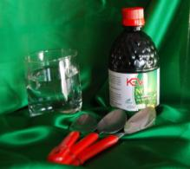
Dos’ & Don’ts for Keva Noni
For best results, take Keva Noni twice daily.
Dilute Keva Noni in 150ml water or any other juice.
You can take it 2-3 hrs after meal, if before meal it is not possible.
Always use measuring cap.
Always drink Keva Noni on an empty stomach or at least 30 minutes before meal.

Slide 27

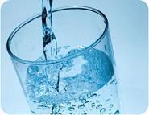

Dos’ & Don’ts for Keva Noni
Take lots of clean water along with Keva Noni.
For better results drink Keva Noni in a glass tumbler only.
Use Keva Noni twice daily for 6 to 12 months for better results.
Keva Noni is not recommended for children below one year.

Slide 28
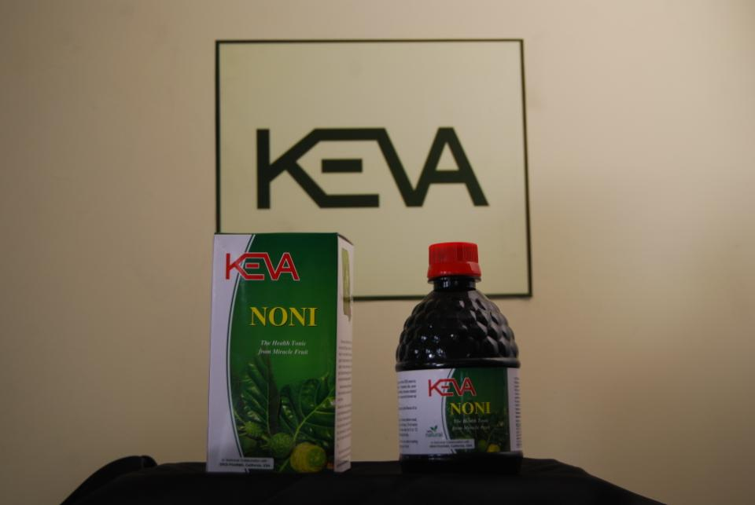
Dos’ & Don’ts for Keva Noni
Drink plenty of good clean water throughout the day to help your body flush out toxins.
If you get a Cleansing Response (a headache, soft motion, belching or itchy skin), drink more water and skip a dose or two depending on how you feel. Most symptoms disappear within 24 hours of discounting Noni.

Slide 29
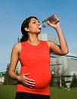

Dos’ & Don’ts for Keva Noni
It is not recommended to give Keva Noni to pregnant and lactating women.
Moderately increased dosages are safe as per the condition of body, but larger amounts may cause a laxative effect.
Wait at least half an hour before drinking alcohol, coffee, tea, soda or eating anything. Alcohol, caffeine and food cancel out the effectiveness of Noni.

Slide 30




Testimonials
Due to wrong eating habits my digestive system had been effected a lot. I tried a lots of medicines but these lead due to rather acidity. But after using Keva Noni I felt difference in 10 days. Now I stay fresh always.
Kevin Taylor
35 yrs
Male
California, USA

Slide 31
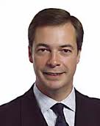
Testimonials
I was feeling low from last few weeks followed with vomiting, stomach ache due to liver infection. But Keva Noni has given me a permanent relief to this problem
Jordan Fox
26 yrs
Male
San Francisco, USA

Slide 32

Testimonials
I have to keep myself energetic 24 hours. I tried many multi vitamins but Keva Noni has really proved the best solution to me. Now I am always active
Andrea Wright
27 yrs
Female
Los Angeles, USA

Slide 33

Testimonials
Diabetes & cancer are 2 such problems which are being suffered by majority in my family for years. I am using Keva Noni as a precautionary measure for so long time & am absolutely fit & fine
Robert Parker
40 yrs
Male
Sacramento, USA

Slide 34

Testimonials
I was having high cholesterol followed with high blood pressure. But after switching to Keva Noni I am a normal person now & feel the same energy in myself which I had 25 yrs back
Steven Cooper
51 yrs
Male
San Diego, USA

Slide 35


Slide 36
Keva Noni is not an alternative to medicine or food. It improves the efficacy and can also be taken together with any medications - there are almost no negative interactions. In some situations, Keva Noni allows other medications to act more efficiently.
Note: This product is not intended to treat, cure or prevent any disease. Please consult your health care professional.

Slide 37
Contact:
Keva Industries
An ISO 9001:2008 Certified Company
Level 2, Prestige Omega,
No. 104, EPIP Zone,
Whitefield, Bangalore-560066 (India)
Web: www.kevaind.org

Slide 38


