Slide 1
Keva Bright toothpaste
By Keva Industries

Slide 2
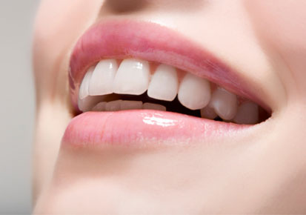
Keva Bright toothpaste
100% Natural Ayurvedic Toothpaste with Green Mark
Free from Parabens & Fluoride
All In One Toothpaste
Maintain Overall Oral Health
Whiten & Brighten Teeth
Deodorize mouth
Remove stains from tooth
Restore and protect enamel
Use twice a day, morning and evening before going to bed. For better results use for 6-12 months regularly.

Slide 3
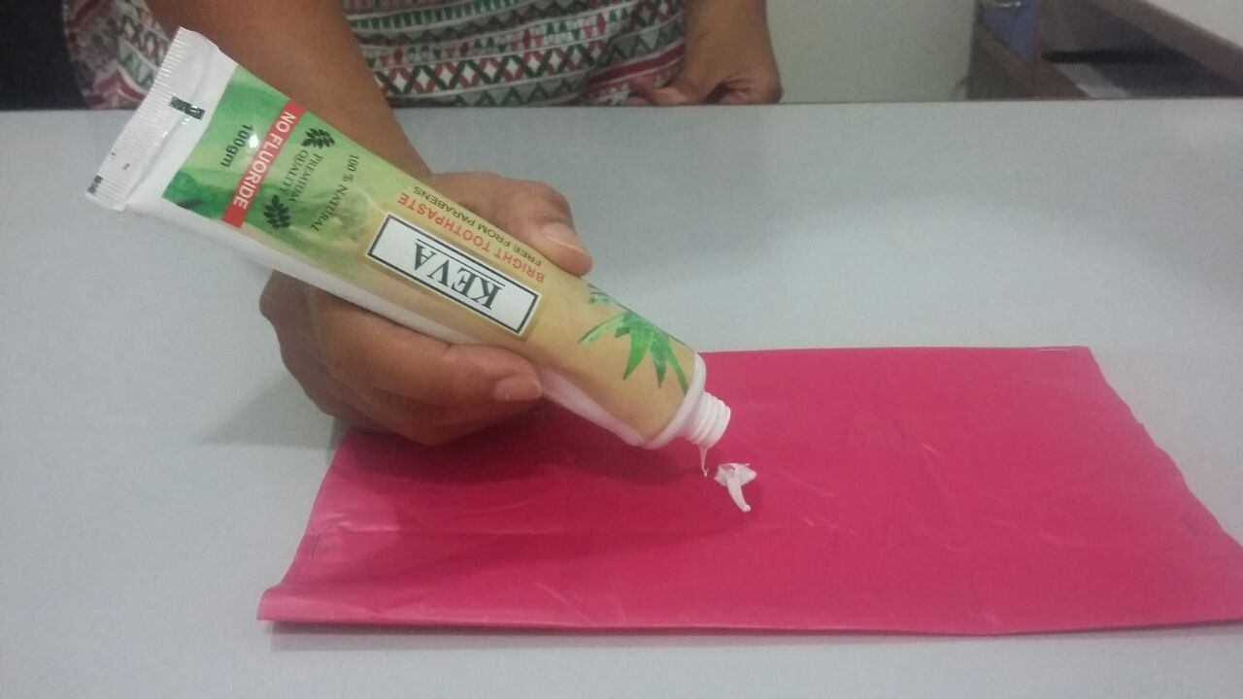
test to check product quality
Take a piece of plastic sheet
Put a small amount of Keva Bright Toothpaste on plastic
sheet

Slide 4
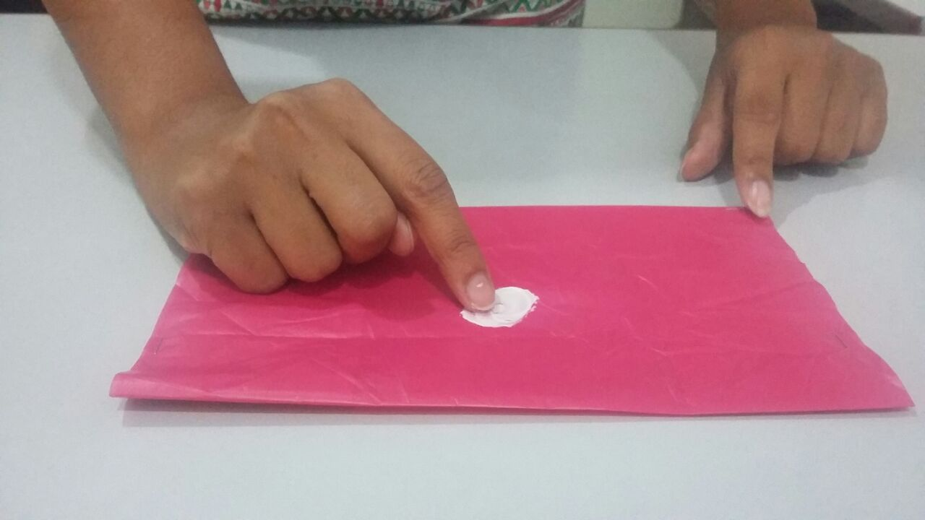
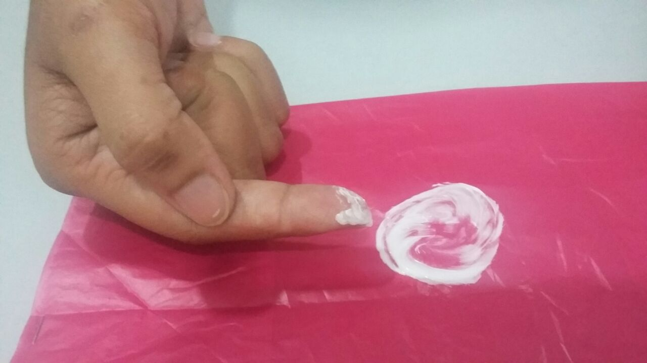
Live demo test
Rub the toothpaste with finger tip for some time in circular motion
Keva Bright Toothpaste will not erode the ink, causes no discoloration

Slide 5
conclusion
Shows that Keva Bright Toothpaste contains mild polishing agents which are gentle on the enamel, but at the same time, remove stains & plaque
If we use Keva Bright Toothpaste on regular basis then it will gently remove surface stains & discoloration, giving safe enamel polishing

Slide 6
Note: This is not a medicine & not intended to treat, prevent & cure any diseases. Please consult your health professional.

